Slide 1
Spark GraphX : Graph Processing with Spark

Slide 2
Graph Processing in Spark
A graph provides a better representation of data than a collection.
A graph-oriented data, a graph provides an easy-to-understand and intuitive model for working with data
Specialized algorithms are available for processing graph-oriented data.
Examples:
  Internet → large graph
  Social networks can be represented as graphs

Slide 3
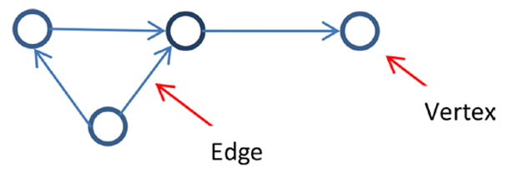
Graph Processing in Spark
A graph is a data structure composed of vertices and edges G = (V,E)
  A vertex is a node in graph.
  An edge connects two vertices in a graph
  A vertex represents an entity and an edge represents a relationship between two entities.
Directed graph
Undirected graph
Directed multigraphs

Slide 4
Graph Processing in Spark
Directed multigraphs
  A directed multigraph is a directed graph that contains pairs of vertices connected by two or more parallel edges.
  Parallel edges in a directed multigraph are edges with the same originating and terminating vertices.
  They are used for representing multiple relationships between a pair of vertices.

Slide 5
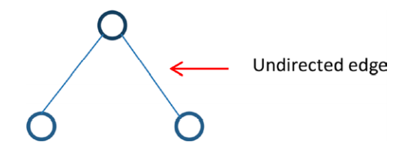
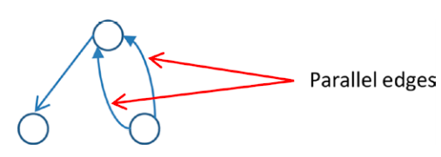
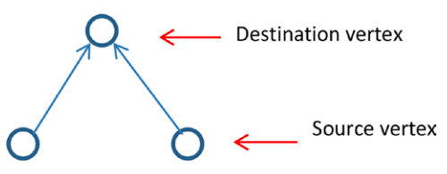
Graph Processing in Spark

Slide 6
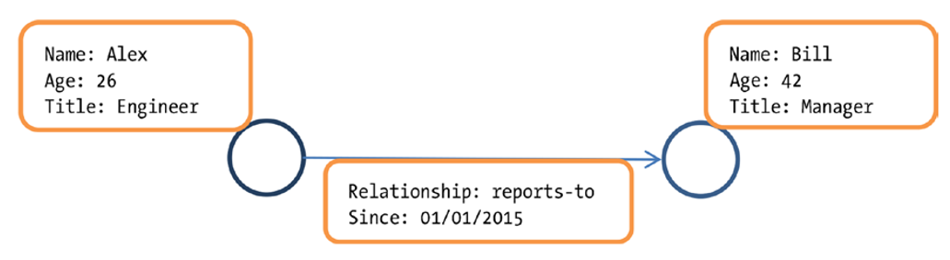
Graph Processing in Spark
Property Graphs:
  It is a directed multigraph that has data associated with the vertices and the edges
  Each vertex in a property graph has attributes or properties.
  Each edge has a label or Properties.
  It provides rich abstraction for working in graphs

Slide 7
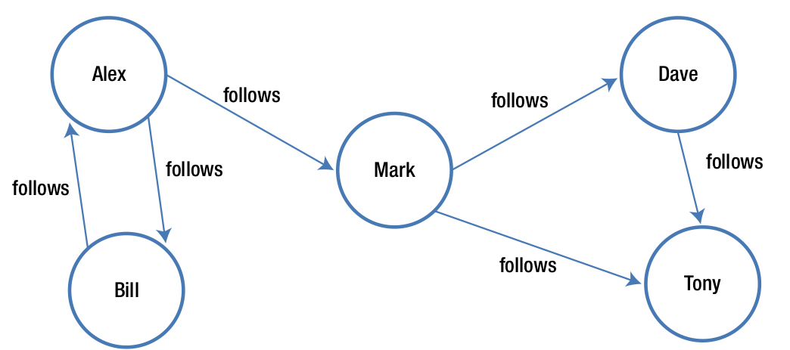
Graph Processing in Spark
Example of Property Graph: Social Network Graph on Twitter

Slide 8
Graph Processing in Spark
GraphX:
It is a distributed graph analytics framework.
It is a Spark library that extends Spark for large-scale graph processing.
It provides a higher-level abstraction for graphs analytics.
It also provides advanced operations (page rank, strongly connected component, triangle count) on graph along basic graph operations 1
A key benefit of using GraphX is that it provides an integrated platform for complete graph analytics workflow or pipeline

Slide 9
Graph Processing in Spark
GraphX:
  A graph analytics pipeline generally consists of the following steps:
    Read raw data → xml file, database tables, csv, etc
    Pre-process data
    Extract vertices and edges to create a property graph
    Slice the graph
    Run the graph algorithm
    Analyze the results
    Repeat the few steps for subgraph 2
  A GraphX user has access to both GraphX and Spark APIs, including the RDD and DataFrame APIs.

Slide 10
Graph Processing in Spark
GraphX API:
  It provides data types for representing graph-oriented data and operators for graph analytics.
  Data Abstraction: Key data types working with property graphs
    VertexRDD
    Edge
    EdgeRDD
    EdgeTriplet and
    Graph

Slide 11
Graph Processing in Spark
VertexRDD:
  It represents a distributed collection of vertices in a property graph.
  It provides a collection view of the vertices in a property graph
  It stores only one entry for each vertex.
  Each vertex is represented by a key-value pair. Key → unique ID and value → data associated with vertex.
  The datatype of key is VertexId (64 bit long) and value can be any type
  It is a generic or parametric class → it requires a type parameter.
  VertexRDD[VD] , VD specifies the data type of the attribute or property associated with each vertex in a graph → VertexRDD[String], VertexRDD[Int] etc

Slide 12
Graph Processing in Spark
GraphX API:
Edge
  The Edge class abstracts a directed edge in a property graph.
  An instance of Edge class contains source vertex Id, Destination vertex ID and edge attribute
  It is also a generic class, so requires type parameter
  The type parameter specifies the data type of the edge attribute
  Edge can have attribute type Int, Long, Double, String, etc
EdgeRDD:
  It represents a distributed collection of the edges in a property graph
EdgeTriplet:
  An instance of this class represents the combination of an edge and two vertices that it connects

Slide 13
Graph Processing in Spark
GraphX API:
EdgeContext:
  The EdgeContext class combines EdgeTriplet with methods to send messages to source and destination vertices of an edge.
Graph
  Graph is GraphX’s abstraction for representing property graphs
  An instance of the Graph class represents a property graph.
  it is immutable, distributed, and fault-tolerant

Slide 14
Graph Processing in Spark
Creating a Graph:
An instance of the graph can be created in several ways.
The GraphX library provides an object named Graph, which provides factory methods for constructing graphs from RDDs.
Another method that creates a graph from an RDD of edges, assigning user-provided default values to the vertices referred by the edges.
The GraphX library also provides an object named GraphLoader, which contains a method named edgeListFile.
The edgeListFile method creates an instance of the Graph class from a file containing a list of directed edges.

Slide 15
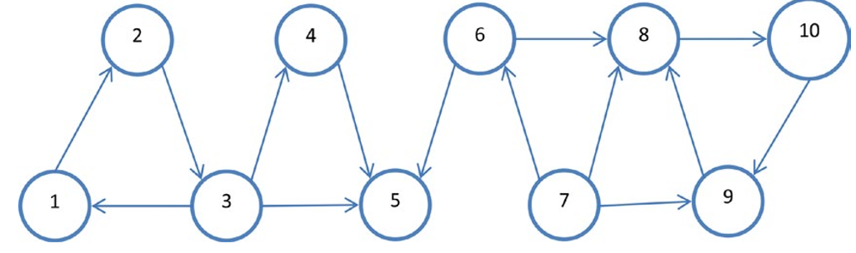
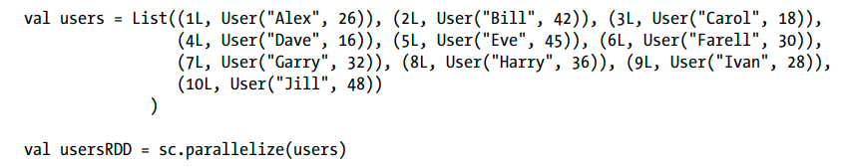
Graph Processing in Spark
Creating a Graph:

Slide 16
Graph Processing in Spark
Creating a Graph:
import org.apache.spark.graphx._
Create a case class to represent a user. Each user will have two attributes or properties: name and age.
case class User(name: String, age: Int)
create an RDD of id and user pairs.
val follows = List(Edge(1L,2L, 1), Edge(2L, 3L, 1), Edge(3L, 1L, 1), Edge(3L, 4L, 1), Edge(3L,5L, 1), Edge(4L, 5L, 1), Edge(6L, 5L, 1), Edge(7L, 6L,1), Edge(6L,8L, 1), Edge(7L, 8L, 1), Edge(7L, 9L, 1), Edge(9L, 8L, 1), Edge(8L,10L,1), Edge(10L, 9L, 1), Edge(1L, 11L, 1) )
Val followsRDD = sc.parallelixe(follows)
val usersRDD = sc.parallelize(users)

Slide 17
Graph Processing in Spark
Creating a Graph:
The preceding code creates an RDD of key value pairs, where the key is a unique identifier and value is a user attributes.
The key represents a vertex id.
create an RDD of connections between users.
A connection can be represented by an instance of the Edge case class.
An edge can have any number of attributes
however, to keep things
simple, assign a single attribute of type Int to each edge.

Slide 18
Graph Processing in Spark
Creating a Graph:
val follows = List(Edge(1L,2L, 1), Edge(2L, 3L, 1), Edge(3L, 1L, 1), Edge(3L, 4L, 1), Edge(3L,5L, 1), Edge(4L, 5L, 1), Edge(6L, 5L, 1), Edge(7L, 6L,1), Edge(6L,8L, 1), Edge(7L, 8L, 1), Edge(7L, 9L, 1), Edge(9L, 8L, 1), Edge(8L,10L,1), Edge(10L, 9L, 1), Edge(1L, 11L, 1) )
val followsRDD = sc.parallelize(follows)
val defaultUser = User("NA", 0)
Now you have all the components required to a construct a property graph.

Slide 19
Graph Processing in Spark
Creating a Graph:
val socialGraph = Graph(usersRDD, followsRDD, defaultUser)
The Graph object in above snippet creates an instance of the Graph class from RDD of Vertices and Edges.

Slide 20
Graph Processing in Spark
Graph Properties:
  find the number of edges or vertices in a property graph
  val numEdges = socialGraph.numEdges
  val numVertices = socialGraph.numVertices
  find the degrees of the vertices in a property graph
  val inDegrees = socialGraph.inDegrees
  inDegrees.collect
  val outDegrees = socialGraph.outDegrees
  outDegrees.collect
  val degrees = socialGraph.degrees
  val degrees = socialGraph.degrees
  degrees.collect

Slide 21
Graph Processing in Spark
Graph Properties:
  The next code snippet shows how to obtain a collections view of the vertices, edges, and triplets in a property graph.
  val vertices = socialGraph.vertices
  val edges = socialGraph.edges
  val triplets = socialGraph.triplets
  triplets.take(3)
  The collections view of the triplets in a property graph allows you to process a graph as a table of source vertex, destination vertex and edge properties
  val follows = triplets.map{ t => t.srcAttr.name + " follows " + t.dstAttr.name}
  follows.take(5)

Slide 22
Graph Processing in Spark
Graph Properties: The Graph operators can be grouped into the following categories:
  Property transformation
  Structure transformation
  Join
  Aggregation
  Graph-parallel computation
  Graph algorithm

Slide 23
Graph Processing in Spark
Graph Operators: Property Transformation Operators → allows to change the properties of edges or vertices in a graph
  mapVertices:
    This method applies a user-specified transformation to each vertex in a property graph.
    It returns the new graph
    Inputs: pair of vertexID and vertex attributes as arguments
    The following example shows how you can use the mapVertices method to increase the age of every user in the social graph that you created earlier.
    val updatedAges = socialGraph.mapVertices( (vertexId, user) => User(user.name, user.age + 5 ))
    socialGraph.vertices.take(5)
    updatedAges.vertices.take(5)

Slide 24
Graph Processing in Spark
Graph Operators:
  mapEdges:
    This method applies a user-specified transformation to each edge in a property graph.
    It returns the new graph
    Inputs: attributes of an edge as argument
    The following example modifies the label of each edge from an integer to a string.
    val followsGraph = socialGraph.mapEdges( (n) => "follows")
    socialGraph.edges.take(5)
    followsGraph.edges.take(5)

Slide 25
Graph Processing in Spark
Graph Operators:
  mapTriplets:
    This method applies a user-specified transformation to each triplets in a property graph.
    It returns the new graph
    Similar to the mapEdges method
    Inputs: EdgeTriplets
    Every edge in the example social graph has an integer attribute whose value is always 1. Suppose you wanted to change the label of the edges based on the source and destination vertices.
    The following code snippet changes an edge label to 2 if the age of a follower is greater than 30.
    val weightedGraph = socialGraph.mapTriplets{ t => if (t.srcAttr.age >= 30) 2 else 1 }
    socialGraph.edges.take(10)
    weightedGraph.edges.take(10)

Slide 26
Graph Processing in Spark
Graph Operators: Structure Transformation Operators → returns a graph that is structurally different from the graph on which the operators was called.
  reverse:
    This method reverses the direction of all the edges in a property graph.
    It returns a new property graph
    The following code snippet reverses the follow relationship in the example social graph.
    val reverseGraph = socialGraph.reverse
    reverseGraph.triplets.map{ t => t.srcAttr.name + " follows " + t.dstAttr.name}.take(10)
    socialGraph.triplets.map{ t => t.srcAttr.name + " follows " + t.dstAttr.name}.take(10)

Slide 27
Graph Processing in Spark
Graph Operators: Structure Transformation Operators
  subgraph:
    This method applies a user-specified filter to each vertex and edge.
    It returns a subgraph of the source graph
    It takes two predicates as arguments. 1. EdgeTriplet 2. pair of vertexID and vertex property.
    The following code snippet creates a subgraph that contains only edges with weight greater than 1.
    val subgraph = weightedGraph.subgraph( edgeTriplet => edgeTriplet.attr > 1, (vertexId, vertexProperty) => true)
    subgraph.edges.take(10)
    weightedGraph.edges.take(10)

Slide 28
Graph Processing in Spark
Graph Operators: Structure Transformation Operators
  mask:
    This method takes a graph as argument and returns a subgraph of the source graph containing all the vertices and edges in the input graph.
    The returned graph contains vertices and edges that exist in both the input graph and source graph
    The following example uses the mask method to obtain a subgraph of the social graph. It is a contrived example that assumes that you have a list of edges, but do not have the properties of the edges or vertices connected by those edges.

Slide 29
Graph Processing in Spark
Graph Operators: Structure Transformation Operators
  mask:
    val femaleConnections = List(Edge(2L, 3L, 0), Edge(3L, 1L, 0), Edge(3L, 4L, 0), Edge(3L, 5L, 0), Edge(4L, 5L, 0), Edge(6L, 5L, 0), Edge(8L, 10L, 0), Edge(10L, 9L, 0) )
    val femaleConnectionsRDD = sc.parallelize(femaleConnections)
    val femaleGraphMask = Graph.fromEdges(femaleConnectionsRDD, defaultUser)
    val femaleGraph = socialGraph.mask(femaleGraphMask)
    femaleGraphMask.triplets.take(10)
    femaleGraph.triplets.take(10)

Slide 30
Graph Processing in Spark
Graph Operators: Structure Transformation Operators
  groupEdges:
    This method merges parallel edges in a property graph
    The following example code reduces the size of a graph by merging parallel edges connecting the same pairs of vertices.
    val multiEdges = List(Edge(1L, 2L, 100), Edge(1L, 2L, 200),Edge(2L, 3L, 300), Edge(2L, 3L, 400), Edge(3L, 1L, 200), Edge(3L, 1L, 300) )
    val multiEdgesRDD = sc.parallelize(multiEdges)
    val defaultVertexProperty = 1
    val multiEdgeGraph = Graph.fromEdges(multiEdgesRDD, defaultVertexProperty)

Slide 31
Graph Processing in Spark
Graph Operators: Structure Transformation Operators
  groupEdges:
    import org.apache.spark.graphx.PartitionStrategy._
    val repartitionedGraph = multiEdgeGraph.partitionBy(CanonicalRandomVertexCut)
    val singleEdgeGraph = repartitionedGraph.groupEdges((edge1, edge2) => edge1 + edge2)
    multiEdgeGraph.edges.collect
    singleEdgeGraph.edges.collect

Slide 32
Graph Processing in Spark
Graph Operators: Join Operators → allow you to update existing properties or add a new property to the vertices in a graph.
  joinVertices:
    This method updates the vertices in the source graph with a collection of vertices provided to it as input.
    It takes two argument: 1. RDD of vertexID and vertex data pairs 2. user specified function that updates a vertex in source graph
    Suppose that you found that the ages of users with vertex id 3 and 4 in the example social graph are incorrect.
    The following code example uses the joinVertices method to correct the ages of those two users.

Slide 33
Graph Processing in Spark
Graph Operators: Join Operators → allow you to update existing properties or add a new property to the vertices in a graph.
  joinVertices:
    val correctAges = sc.parallelize(List((3L, 28), (4L, 26)))
    val correctedGraph = socialGraph.joinVertices(correctAges)((id, user, correctAge) => User(user.name, correctAge))
    correctedGraph.vertices.collect
    socialGraph.vertices.collect

Slide 34
Graph Processing in Spark
Graph Operators: Join Operators → allow you to update existing properties or add a new property to the vertices in a graph.
  joinVertices:
    The following code snippet makes it easy to compare the properties for the vertices with id 3 and 4 in socialGraph and correctedGraph.
    val incorrectSubGraph = socialGraph.subgraph( edgeTriplet => true, (vertexId, vertexProperty) => (vertexId == 3) || (vertexId == 4))
    val correctedSubGraph = correctedGraph.subgraph( edgeTriplet => true, (vertexId, vertexProperty) => (vertexId == 3) || (vertexId == 4))
    incorrectSubGraph.vertices.collect

Slide 35
Graph Processing in Spark
Graph Operators: Join Operators
  outerjoinVertices:
    This method adds new properties to the vertices in the source graph.
    It takes two argument: 1. RDD of vertexID and vertex data pairs 2. user specified function that contains vertexID, vertex attributes and optional attributes.

Slide 36
Graph Processing in Spark
Graph Operators: Aggregate Operators
  aggregateMessages:
    This method aggregates values for each vertex from neighboring vertices and connecting edges.
    It uses two user-defined functions to do the aggregations.
    It calls these functions for every triplet in a property graph.
    The first user-defined function takes as argument an EdgeContext.
    send messages to the source and destination vertices in a triplet.
    EdgeContext class is used to send messages
    The second user-defined function takes two messages as arguments and returns a single message.
    It merges or combines two messages into a single message.

Slide 37
Graph Processing in Spark
Graph Operators: Aggregate Operators
  aggregateMessages:
    The following code shows how you can use the aggregateMessages method to calculate the number of followers of each user in the example social graph.
    val followers = socialGraph.aggregateMessages[Int]( edgeContext => edgeContext.sendToDst(1), (x, y) => (x + y))
    followers.collect

Slide 38
Graph Processing in Spark
Graph Operators: Aggregate Operators
  aggregateMessages:
    The following code is a simple example for demonstrating how you can use the aggregateMessages method. However, the aggregateMessages method is overkill for calculating the number of followers. A simpler approach is shown next.
    val followers = socialGraph.inDegrees
    followers.collect

Slide 39
Graph Processing in Spark
Graph Operators: Aggregate Operators
  aggregateMessages:
    Let‘s use the aggregateMessages method to solve a slightly more difficult problem.
    The following code snippet shows how you can find the age of the oldest follower of each user.
    val oldestFollower = socialGraph.aggregateMessages[Int]( edgeContext => edgeContext.sendToDst(edgeContext.srcAttr.age), (x, y) => math.max(x,y))
    oldestFollower.collect

